Slide 1
Introduction to Ice Binding Proteins
GROUP 8: 黄昱、黄雨晴、叶君耀、吕夏影、唐宾泽、金恒、刘士卓

Slide 2
Outline
Introduction
Classification and Structure
Function and Properties
  Thermal Hysteresis
  Ice Shaping
  Ice Recrystallization Inhibition (IRI)
The Mechanism of IBP
Challenges and Opportunities

Slide 3
Introduction
Lots of creatures can survive in the subzero habitats, A series of proteins were discovered by scientist from fish, enzymes, insects and plants. They have diversity structures but own the same function: depress the freezing point.
We call those hyperactive and have high Thermal Hysteresis(TH) proteins as Antifreeze Proteins(AFP). Including those have lower TH proteins, we call them Ice Binding Proteins(IBP)
Except that, Polyvinyl Alcohol (PVA) and Antifreeze Glycoproteins (AFGPs) and etc. also have the same functions.

Slide 4
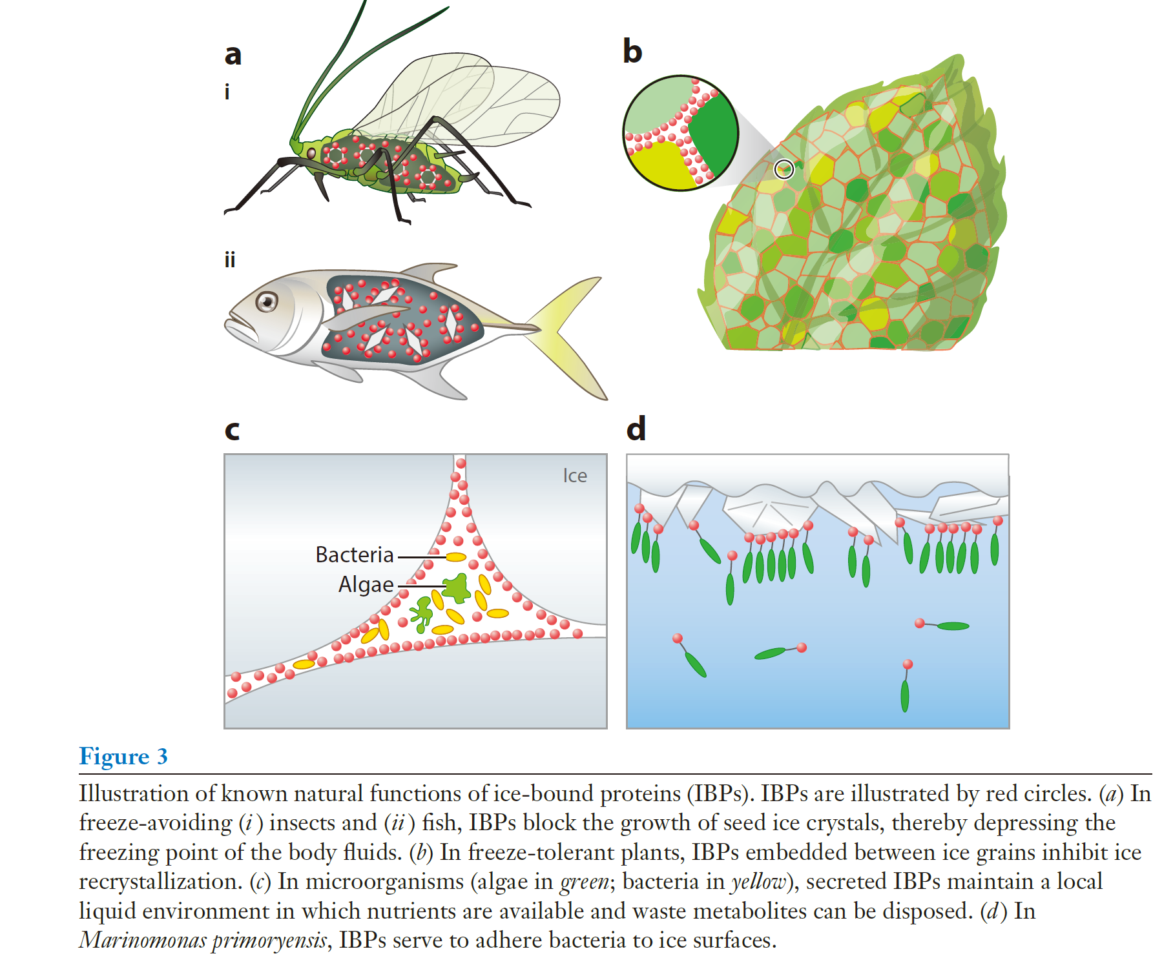
Introduction
Lots of creatures can survive in the subzero habitats. A series of proteins were discovered by scientist from fish, enzymes, insects and plants. They have diversity structures but own the same function: depress the freezing point.
Maya Bar Dolev, Ido Braslavsky, Peter L. Davies. Annual Review of Biochemistry 2016 85: 512-542;
Notes:
自然界中有很多生物，包扩鱼、植物以及细菌，它们能在零度以下的极低温度生存，保持体液不结冰的原因就是存在一类蛋白质，可以结合在冰面上，抑制冰的生长。为什么需要了解这类蛋白质呢，因为生活中，我们有很多地方需要防止结冰，比如说食物储存，低温药物，石油天然气输运，以及航空航天。了解这种蛋白质，有利于我们很好地利用它，不仅如此还可以根据他们的物理化学规律模仿出更加简单高效而又价格低廉的除冰，抗冰材料。

Slide 5
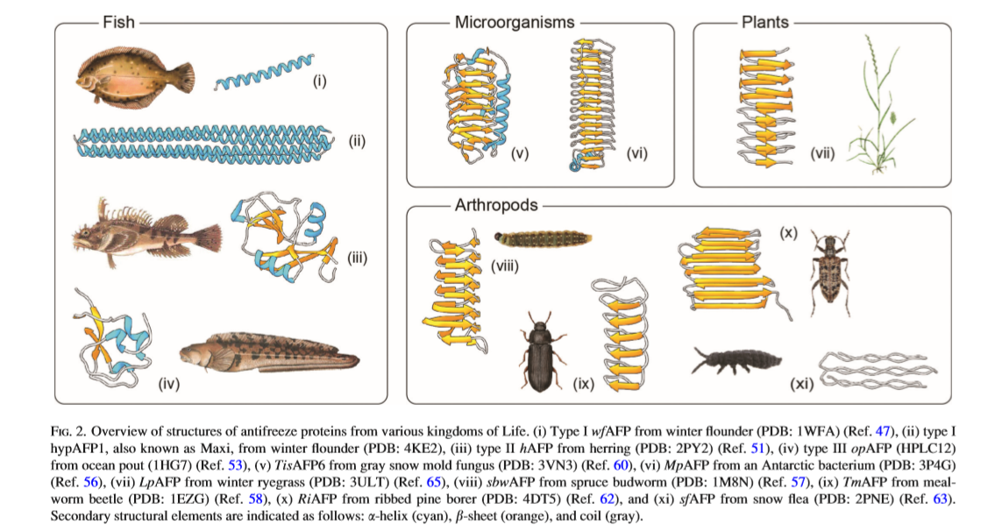
Classification
Maya Bar Dolev, Ido Braslavsky, Peter L. Davies. Annual Review of Biochemistry 2016 85: 512-542;

Slide 6
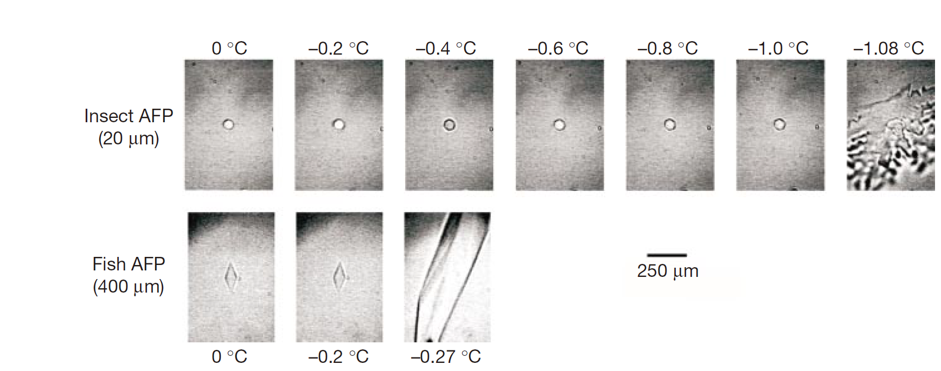
Function
Thermal Hysteresis
Graether, S., Kuiper, M., Gagné, S. et al. Nature 406, 325–328 (2000)

Slide 7
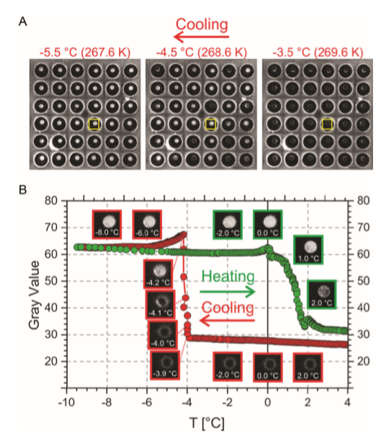
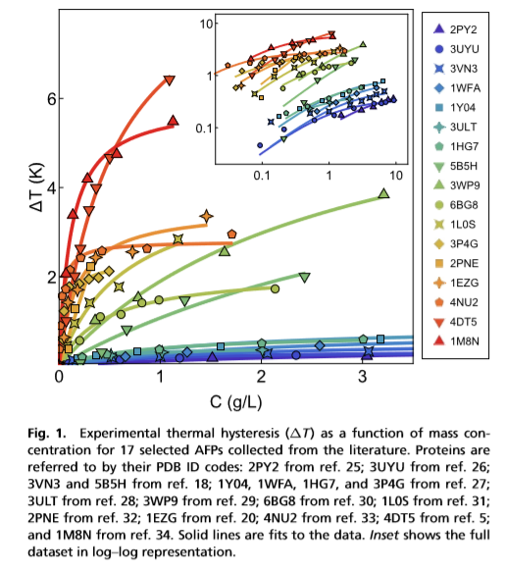
Function
Thermal Hysteresis
Biointerphases 11, 018906 (2016); doi: 10.1116/1.4939462

Slide 8
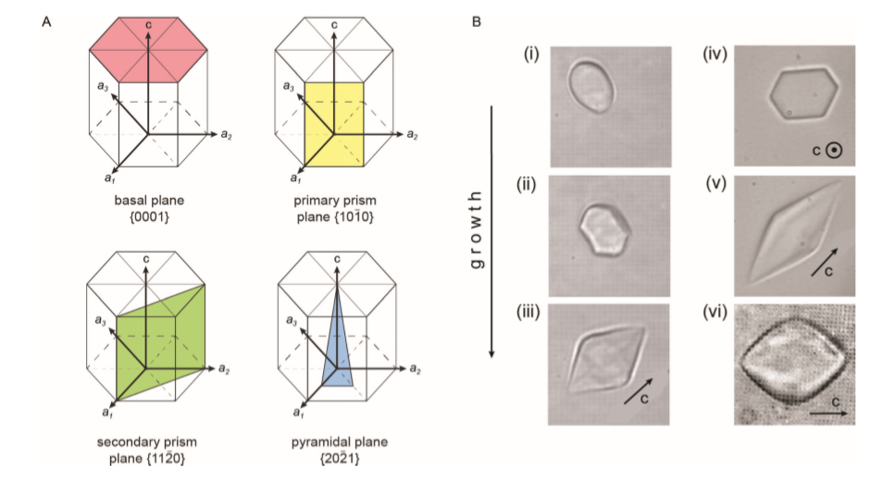
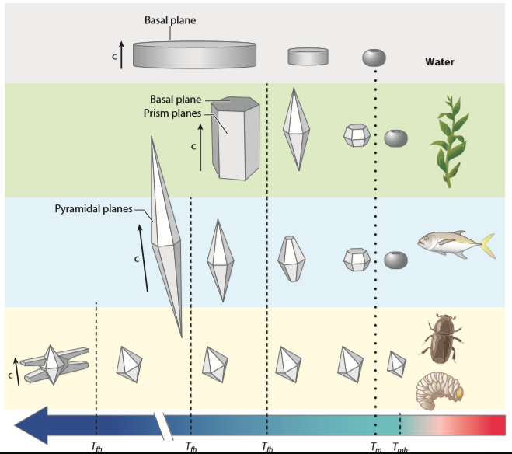
Function
Ice Shaping
Maya Bar Dolev, Ido Braslavsky, Peter L. Davies. Annual Review of Biochemistry 2016 85: 512-542;

Slide 9
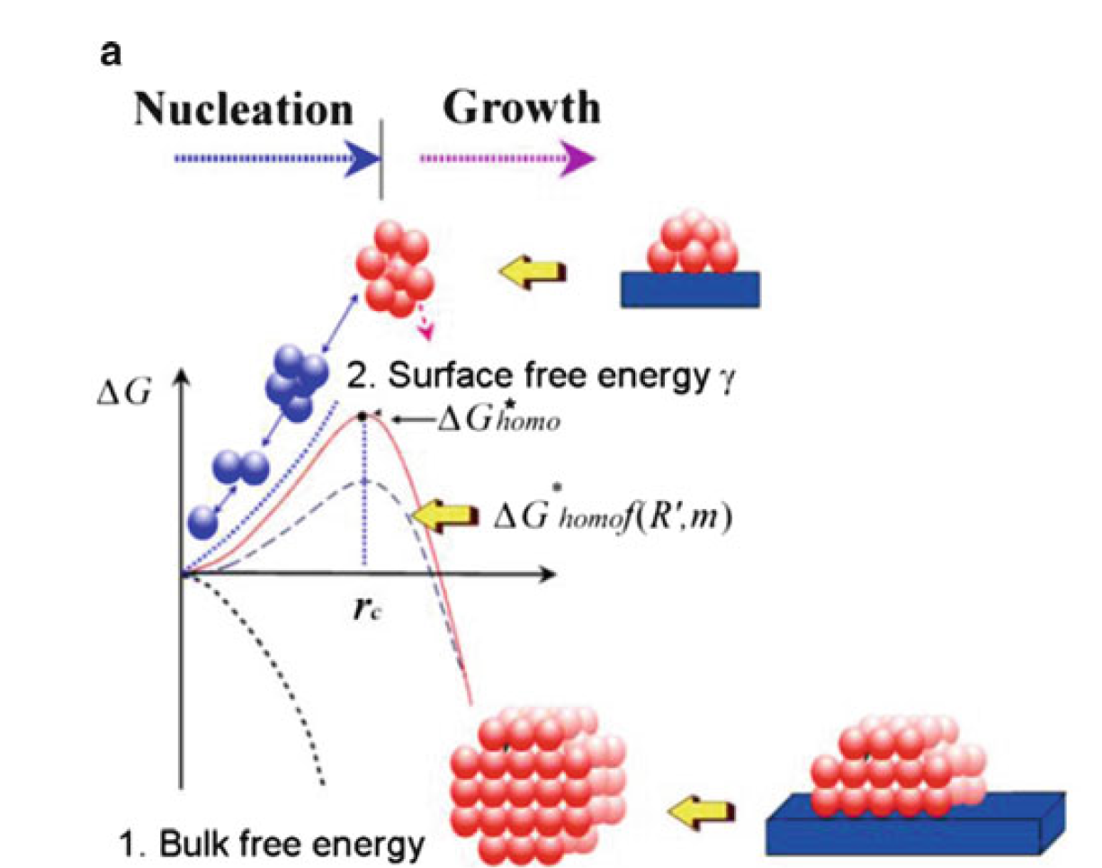


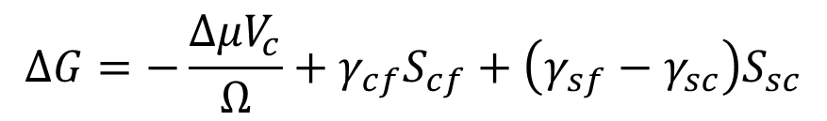
Nucleation Barrier
$$ΔG=G_{fin}−G_{ini}$$
$$ΔG=−nΔμ+Φ_{n}$$
$$ΔG=−\frac{ΔμV_{c}}{Ω}+γ_{cf}S_{cf}+\left(γ_{sf}−γ_{sc}\right)S_{sc}$$

Slide 10
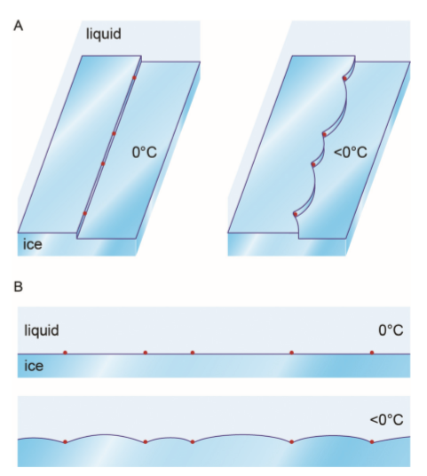
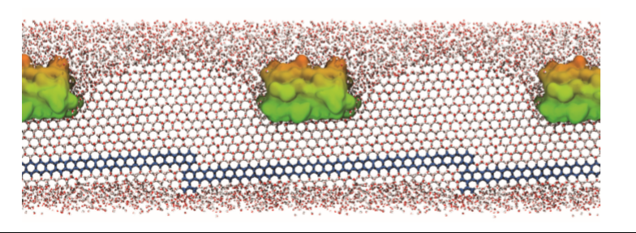
Absorption-Inhibition model
(1) hydrogen-bonding groups on the IBP surface match the ice lattice oxygen atoms,
(2) A flat, hydrophobic protein surface binds ice via the partitioning of hydrophobic side chains within the ice lattice
(3) the binding site develops in a protein-assisted manner via surface-bound waters

Slide 11
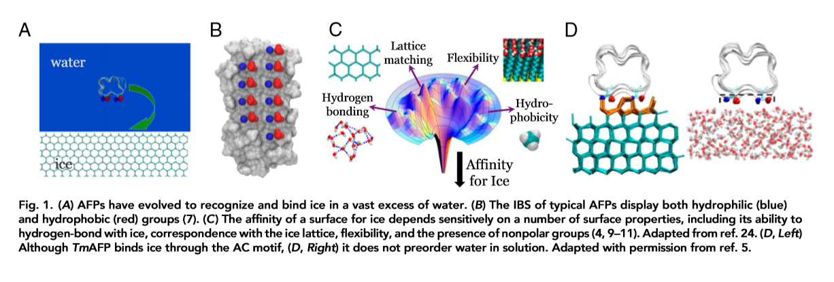
How Do IBPs Binding to Ice?
How do IBPs recognize ice?
How do IBPs binding to ice?
Can this binding reversible?
What factors will affect binding strength and how?

Slide 12
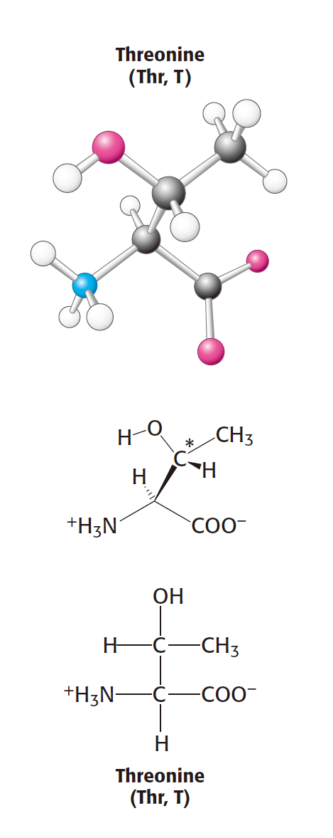
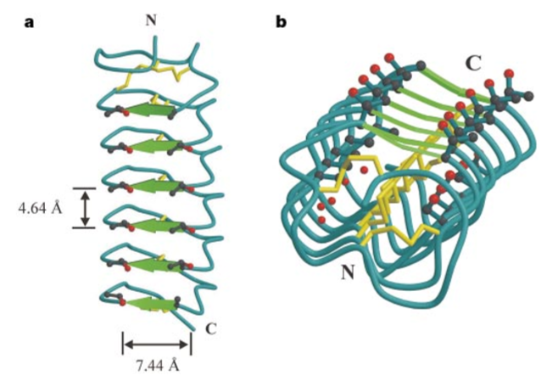
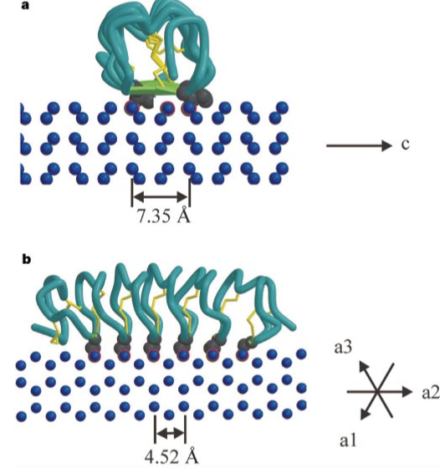
Structure of TmAFP
Graether, S., Kuiper, M., Gagné, S. et al. Nature 406, 325–328 (2000)

Slide 13
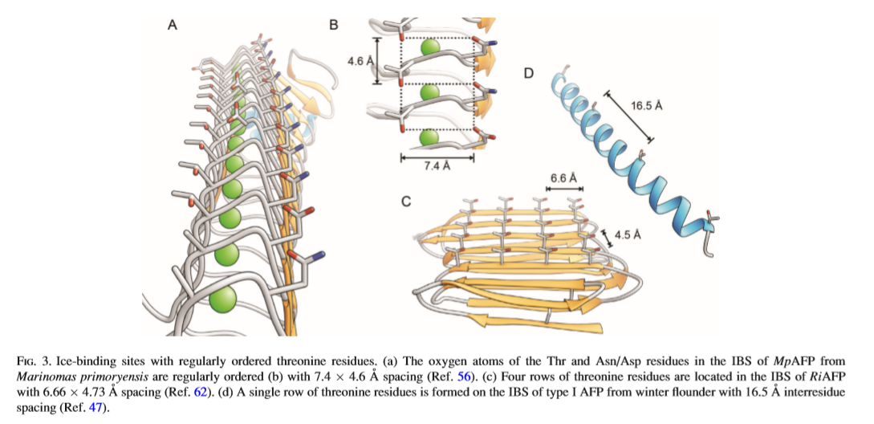
IBS Strcuture
Maya Bar Dolev, Ido Braslavsky, Peter L. Davies. Annual Review of Biochemistry 2016 85: 512-542;

Slide 14
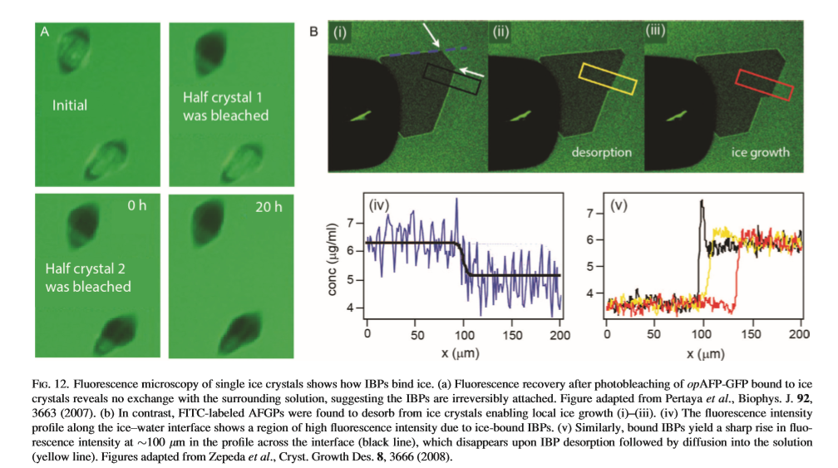
Irreversible or Reversible

Slide 15
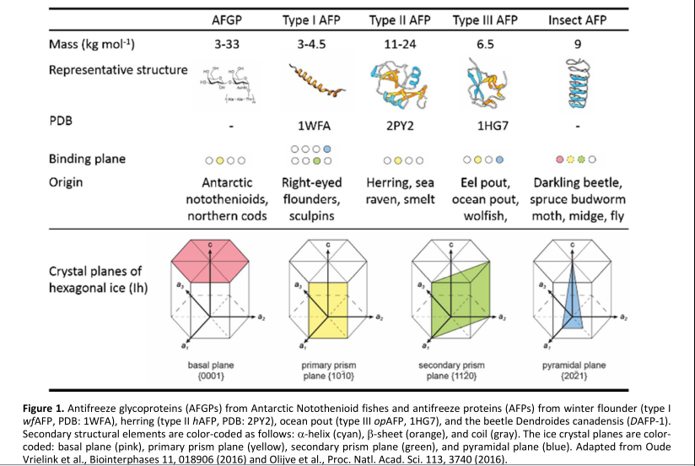
Micro-Insight of Binding

Slide 16
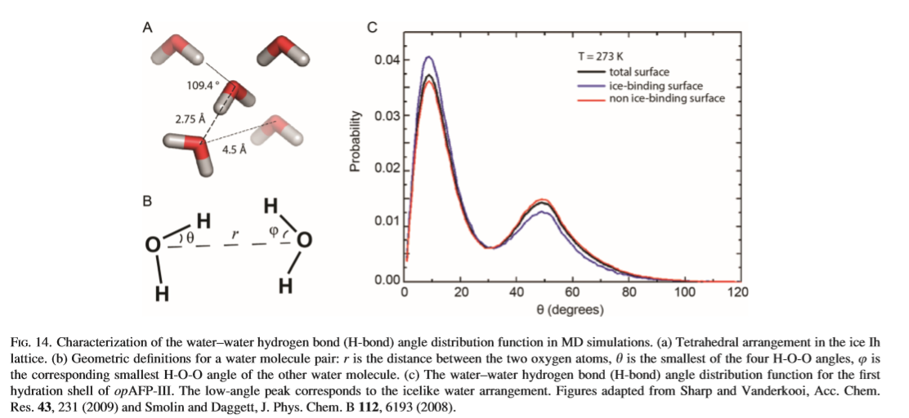
Water near IBS is ordered?
1. Tetrehedral Structure parameter
2. Hydrogen bond life time
3. Water reorientation dynamics
4. Distribution of the OOH

Slide 17
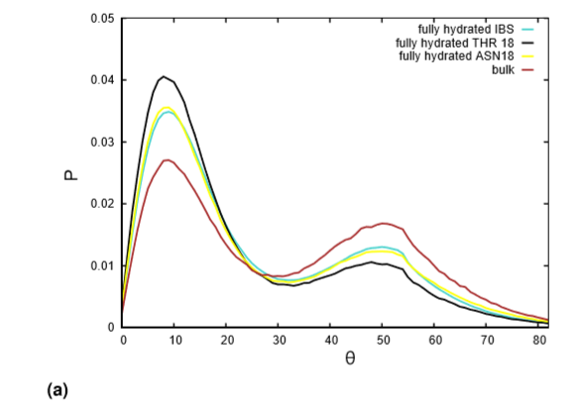
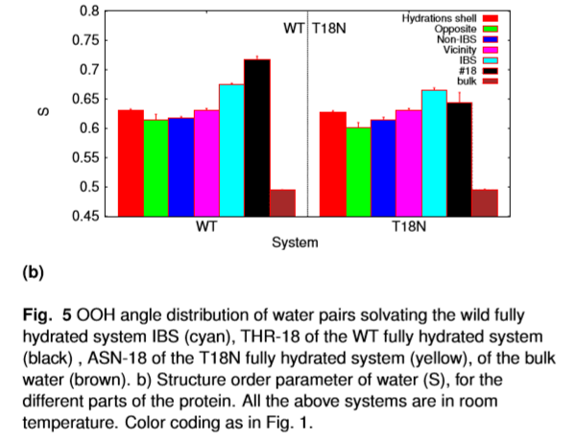
AFP-3 Has Ordered Water

Slide 18
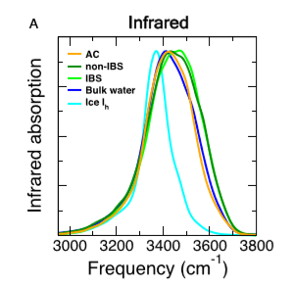
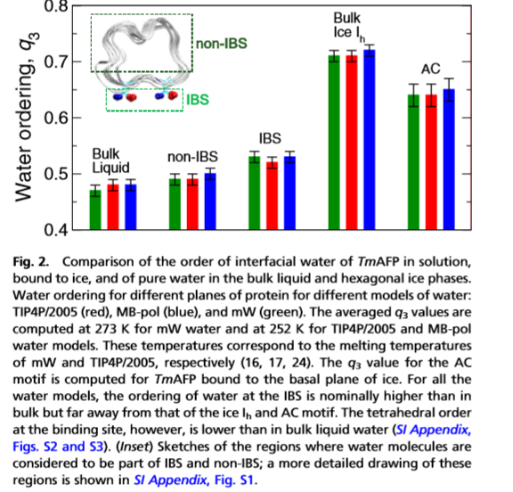
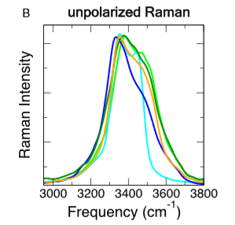
TmAFP Not Obvious

Slide 19
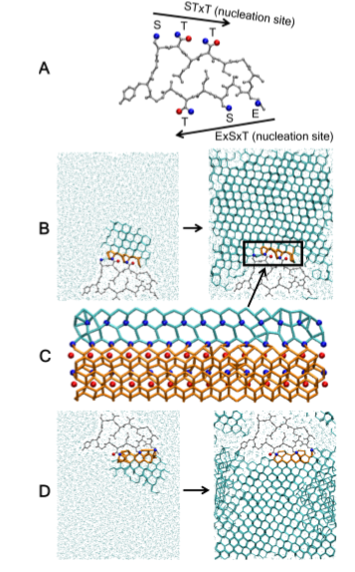
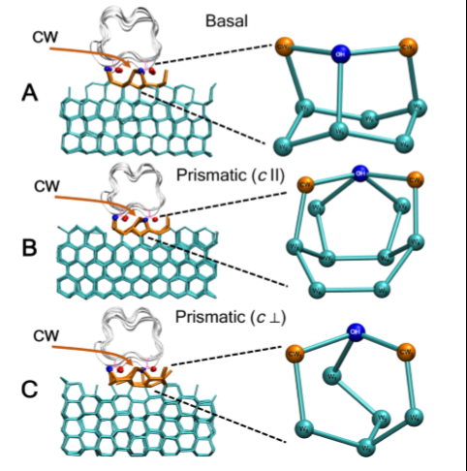
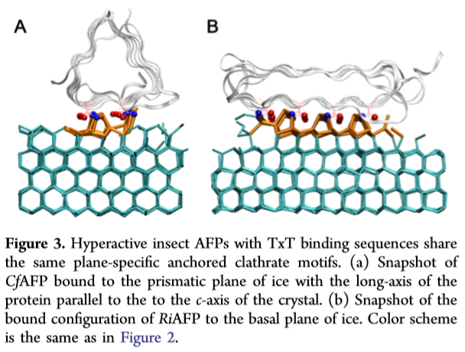
How to bingding the ice
Anchored Clathrate water
Insect hyperactive AFPs bind to ice through three distinct anchored clathrate motifs.
PNAS August 14, 2018 115 (33) 8266-8271

Slide 20
Challenges

Slide 21
Thanks

